Slide 1

Tourism in Nepal
Krishna Hari Adhikari
President
Nepal-Poland Chamber of Commerce & Industry

Slide 2
General Information
Nepal is one of the richest countries in the world in terms of bio-diversity due to its unique geographical position and altitudinal variation.
Area : 147,181 sq. km
Location : Situated between China in the north and India in the south, east and west
Capital : Kathmandu
Population : 25.8 million
People : Nepal has more than 101 ethnic groups and 92 spoken languages.
Language : Nepali is the national language
Religion : Nepal is a secular state with a predominance of Hindu and Buddhist population.
Currency : Nepali Rupee (approximately US$ 1 equals Rs. 78.90
Political System : Federal Democratic Republic
The elevation of the country ranges from 60 m above sea level to the highest point on earth, Mt. Everest at 8,848 m,

Slide 3
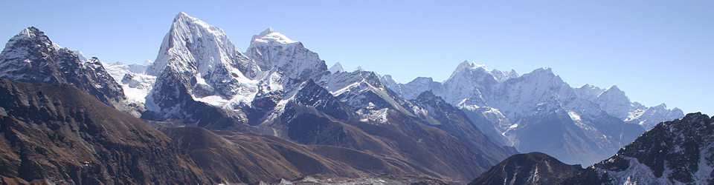
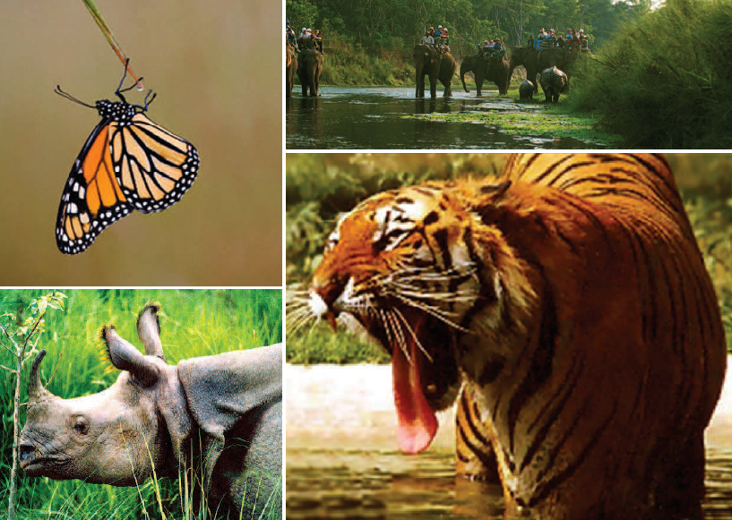
Features
Nepal occupying only 0.1% of the total landmass of the earth is home to:
2% of all the flowering plants in the world
8% of the world’s population of birds (more than 848 species)
4% of mammals on earth
11 of the world’s 15 families of butterflies (more than 500 species)
600 indigenous plant families
319 species of exotic orchids
Nepal's Unique Treasures
Mt. Everest – Highest Point on Earth
Kumari – The Living Goddess
Lumbini- Birth Place of Lord Buddha

Slide 4
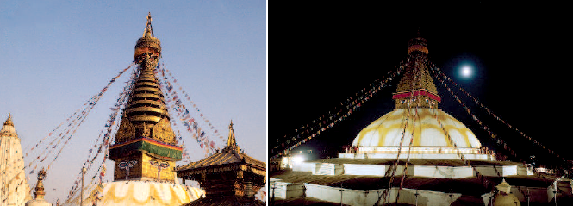

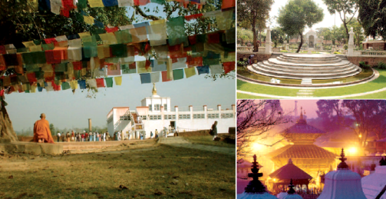
WORLD HERITAGE SITES
There are four UNESCO World Heritage Sites in Nepal. Two are in cultural category and two are in natural category. World Cultural Heritage Sites of Nepal are:
Lumbini, the birth place of Lord Buddha,
Seven monuments of Kathmandu valley within a radius of 20 km (together counted as one Heritage Site).
The World Natural Heritage Sites are Chitwan and Sagarmatha National Parks.
Kathmandu Valley World Heritage Site
Three historical palaces –
  Kathmandu, Patan and Bhaktapur Durbar Squares;
Two Buddhist stupas – Swayambhunath and Bauddhanath;
Two Hindu temples – Pashupatinath and Changu Narayan.

Slide 5

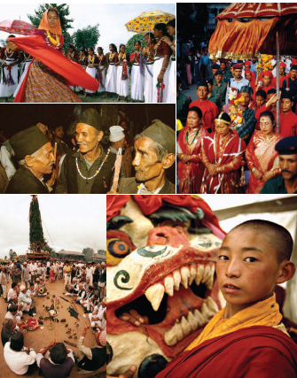
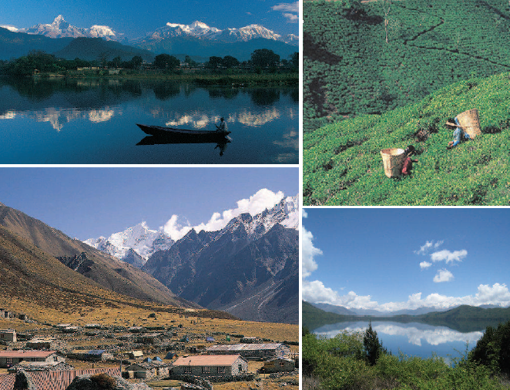
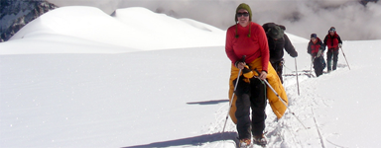
Major attractions
A Variety of New Experiences
• Jungle safari • Bird watching
• Mountaineering • River Rafting
• Mountain flight • Ultra light aircraft
• Paragliding • Special Festivals
• Buddhist sites

Slide 6
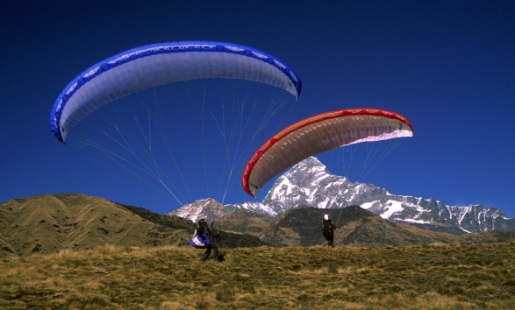
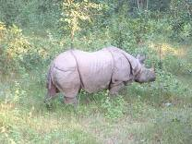
Unique Selling Points
Natural Heritage of Himalaya Range,
National Parks
Cultural Heritage Sights of Kathmandu valley
Pokhara City
Trekking
Pilgrimage tours (for Buddhist & Hindu)
Shopping
Wildlife Safari
Soft adventures
  short trekking ,
  rafting ( grade 2-3)
  mountain flight
Friendly people of Nepal

Slide 7
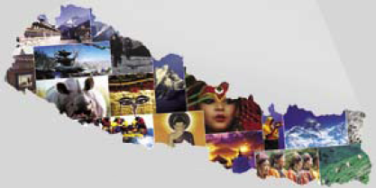
Tourist arrival 2012
 | Year 2011 | Year 2012
Total Tourists | 544,985 | 598204
Major Countries | No. of Tourists
India | 164680
China | 53,373
USA | 41,908
UK | 35583
Germany | 24575
Japan | 24321
France | 24034
Australia | 18756
South Korea | 18544
Bangladesh | 16354
The above data contains arrivals by air route only.

Slide 8
Challenges
frequent strike, blockade
environmental pollution
electricity supply irregular
No direct air connection to Europe and very few international flights having connections to Kathmandu
Weak national flyer
Unable to reap benefits from intra-regional tourism
Failure to provide attractive and incentive packages to travelers from India and China compared to competing destinations

Slide 9
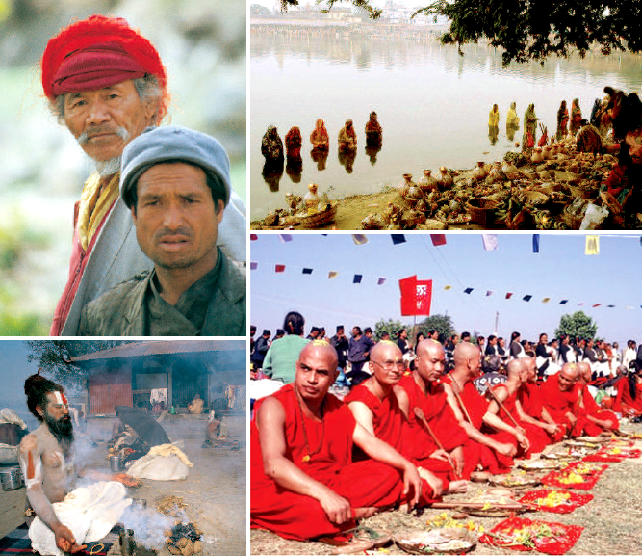
Strength
Natural assets
Cultural diversity
Religious sites
4 World Heritage Sites
Acquired image as an adventure and cultural theme tourism destination
Good service, hospitable nature of the Nepalese people
Expanded air access to major markets
Government promotion of sustainable tourism
Wide array of ecotourism offerings

Slide 10
Thank you
Promote Tourism in Nepal

